Slide 1
CDBG: 50 Years of History, Progression, and Resilience

Slide 2
PRESENTORS
Paul Webster, HUD Director, Financial Management Division
James Barnes, Retired HUD Director and
Local Government Director
Mark Tigan, Professor of Practice, Clark University (Ret.);
CD Director (Ret.)
MODERATOR
Patrick J. Sullivan, Retired Director, Housing and
Community Development, City of New Bedford, MA
Notes:
Introduce my self. I would like to introduce our esteemed panelists and ask them to take a few minutes to describe their career and experience with the Community Development Block Grant Program

Slide 3
CDBG Origins
Federal Grants-in-Aid Began in 1930’s
1949 Housing Act – “A Decent Home and Suitable Living Environment for Every American”
“Categorical” Grants for Planning, Open Space, Water & Sewer, Public Facilities, and Urban Renewal all aimed at ”suitable living environment.”
Myriad housing programs as well from 1949 onward.
1965 – HUD created, consolidated multiple smaller agencies
1971 – HUD field offices created
Notes:
Jim could you walk us through the early origins of CDBG

Slide 4
Johnson Administration – Nov 1963 – Jan 1969
Civil Rights Act of 1964
Fair Housing Act – 1968 - outlaws most housing discrimination, gives HUD enforcement responsibility. Establishes Government National Mortgage Association (Ginnie Mae) to expand availability of mortgage funds for moderate income families using government guaranteed mortgage-backed securities.
War on Poverty – Johnson’s 1964 State of Union speech
The Economic Opportunity Act of 1964 created the Office of Economic Opportunity, Community Action Program (CAP) agencies, VISTA, Head Start
Model Cities Program – 1966 to 1974 (HUD’s Part in War on Poverty)
NCDA grew out of Model Cities Directors Association
Expansion of Urban Renewal and Housing Subsidy Programs
Notes:
Jim could you touch upon these important legislative changes in the Johnson administration. Mark, could you discuss some of the social unrest at that time. Assignation of JFK. Assassination of Martin Luther King 1968 and ensuing race riots

Slide 5
Local Criticism of Existing Grants-In-Aid Programs
and Federal Response
Local governments complain of burdensome individual applications, slow review time, uncertainty of funding, too much decision making at Federal level – many local leaders recommend “block grants”
Nixon Administration responds - explores and then implements what it called “New Federalism”
Consolidate programs, Simplify applications, Move decision-making to local level
At HUD former Mayor, Floyd Hyde, and former Legislative Aid, Warren Butler, start in Nixon administration running Model Cities Program - eventually lead the way on CDBG legislation
Notes:
Mark. Could you add some examples of what some of the criticisms occurred in the early years of federal grant in aide programs. Paul and Jim could you share HUD's perpective.

Slide 6
Nixon Administration – Jan. 1969 – Aug. 1974
George Romney – HUD Secretary ( Mitt Romney’s dad)
Uniform Act and NEPA enacted – 1970. Far reaching implications for HUD and CPD
HUD Field Offices created in almost every state, replaced FHA offices – 1971
Nixon’s Goal - to consolidate programs & transfer decision making power to local gov
Big Debate - Special Revenue Sharing vs. Applications
CDBG a compromise
Better Communities Act morphed into Housing and Community Development Act of 1974
Notes:
Jim, could you speak to the Nixon administration and several key initiatives. Mark – Could you touch upon the early debate of Mayor’s v. Citizen control (via Community Action Programs

Slide 7
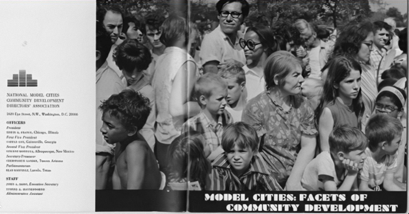
Model Cities Program 1966 - 1974
"Demonstration Cities and Metropolitan Development Act of 1966" became known as the Model Cities Program. Implemented in 1966 by the newly formed US Department of Housing and Urban Development as a corrective to the top-down approach and physical emphasis of urban renewal.
Model Cities was to focus on comprehensive physical and socioeconomic improvements to the country’s most impoverished neighborhoods, with meaningful community participation in planning.
A total of 151 cities nationwide were selected to apply for Model Cities funding.
Notes:
Mark Model Cities began to attempt to address a number of issues confronted by cities. Could you speak to the early years of the program.

Slide 8
Model Cities Program Cambridge, MA
The Harvard Crimson
Model Cities Program Vote Held
By William R. Galeota, December 7, 1968
The residents of Cambridge's model neighborhood are now voting on whether to approve the projects proposed for the first year of work in the Model Cities program.
A neighborhood referendum on 29 separate projects to improve housing, recreation, education, and other services in the neighborhood began Thursday and will end tonight. Each project must receive a majority of the votes cast in order to be included in the formal first-year program which is to be sent to the City Council and then to the Department of Housing and Urban Development.
Cambridge is the only one of the 70-odd communities participating in the Model Cities program that gives residents of the model neighborhood--a 268-acre area east of Central Square--control over the board running the program and the right to veto any of the board's proposals in a referendum.
Notes:
Pat will reference the article and tell a brief story of the Model Cities office in New Bedford being taken over by community activists.

Slide 9
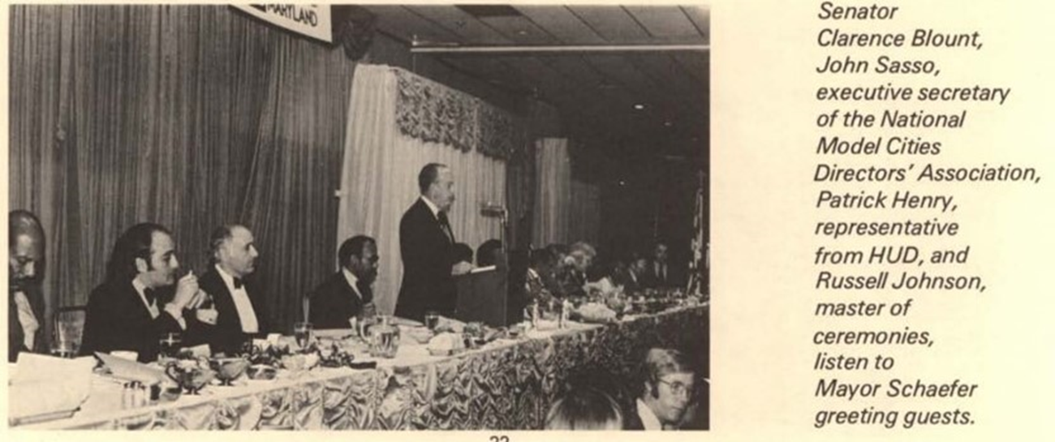
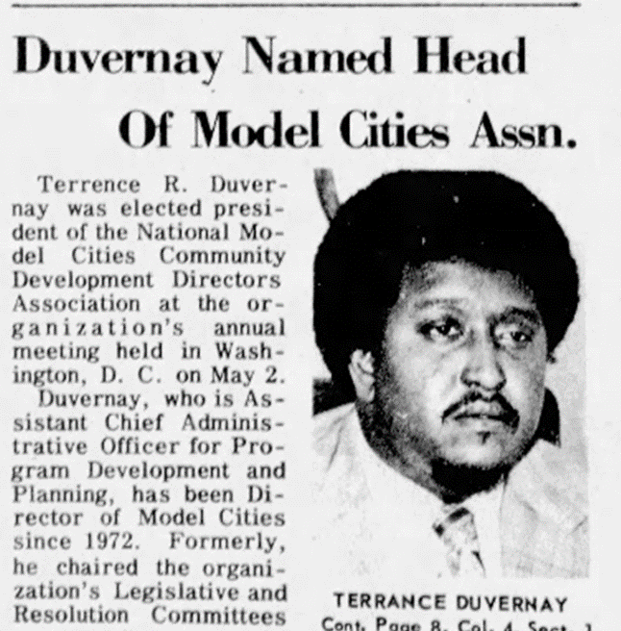
Model Cities Program and
Development of National Community Development Association NCDA
Notes:
Mark tell us a bit about your experience as Model Cities director in Vermont and Santa Monica, CA. Also, a few of us had the pleasure of knowing Terry Duverney, who worked in New Orleans and later at HUD and was heavily involved with Model Cities and NCDA. Mark and Pat can share some Terry stories - including the annual tradition of singing, we shall overcome at NCDA hospitality suite.

Slide 10
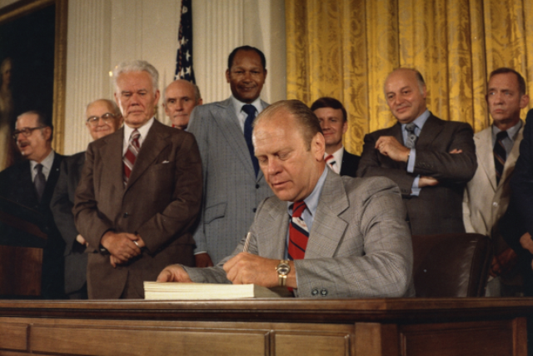
Ford Administration– Aug. 1974 – Jan. 1977
Housing and Community Development Act August 22, 1974
Creation of Community Development Block Grant Program
08/15/1974 House agreed to conference report Voted (377-21).
08/13/1974 Senate agreed to conference report Voted (84-0).
President Ford’s signing statement quoted Senator John Sparkman (D-AL), Chair of the Banking, Housing, and Urban Affairs Committee, who said the HCDA “is probably the most important legislation on community development since the passage of the Housing Act of 1949.”
President Ford stated, “I think we can say without any reservation that the move from the narrow programs of the past in community development to programs that are very broad gauged, a consolidation of programs such as Model Cities and urban development, will give a real impetus to local decision making, local action, and local responsibility.”
Notes:
Act passed with unanimous support in the Senate and incredible bipartidism support in the House. Jim and Paul could you speak to the significance of the Housing and Community Development Act of 1974 from a HUD perspective

Slide 11
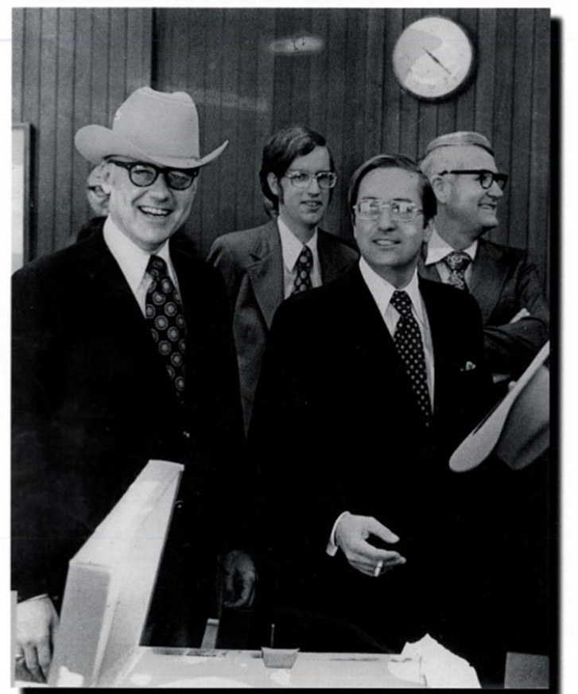
CDBG GRANT SIGNING CEREMONY
Signing ceremony for the first Community Development Block Grant on Feb 5, 1975. On the left, David M. Dewilde, Assistant Secretary HUD, On the right, James T. Lynn, HUD Secretary, and middle of the picture Thomas Utter, Community Development Director, Corpus Christi Texas

Slide 12
CDBG - Several big local issues at the development of CDBG
Role of Citizen Participation - A big concern for mayors
Local Responsibility for Environmental Review under NEPA
CDBG formula issues – Formula B was not added until 1978.
(age of housing - West Coast versus East Coast in formula distribution)
How far can Mayors take flexibility?
Connecting housing with community development by requiring a Housing Assistance Plan
Small Cities Program 1975 – 1981
Big HUD field office workload– reps play a large role in small towns
HUD field offices hold large scale briefings and training
Highly competitive
Each field office designed its own competition, selected winners
Notes:
Jim could you speak to some of the issues that were evident in the early years of the development of CDBG

Slide 13
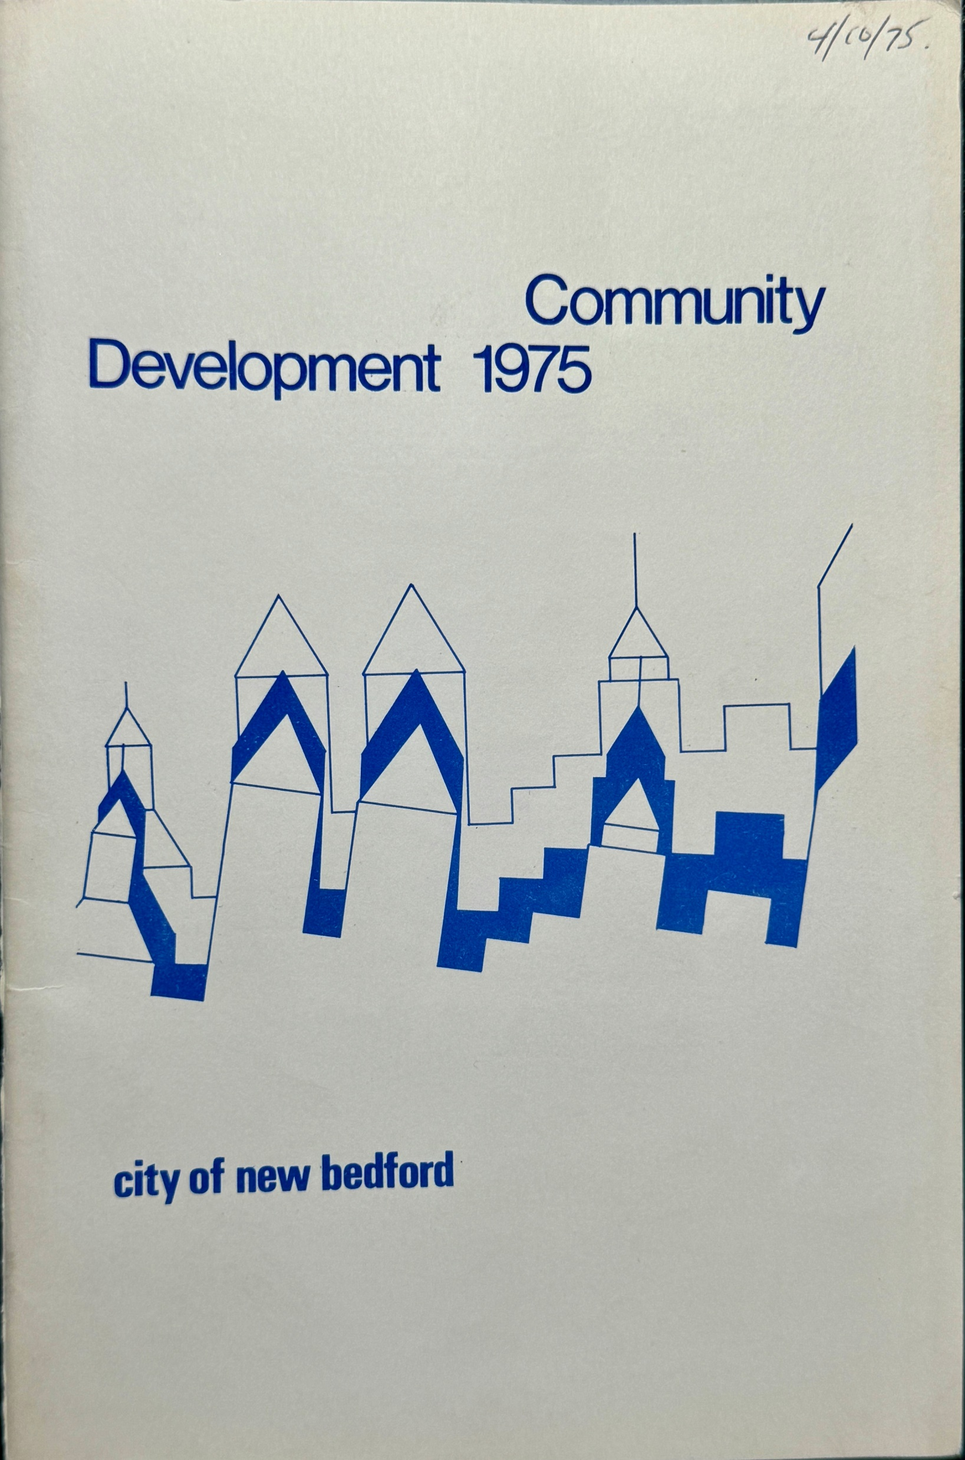
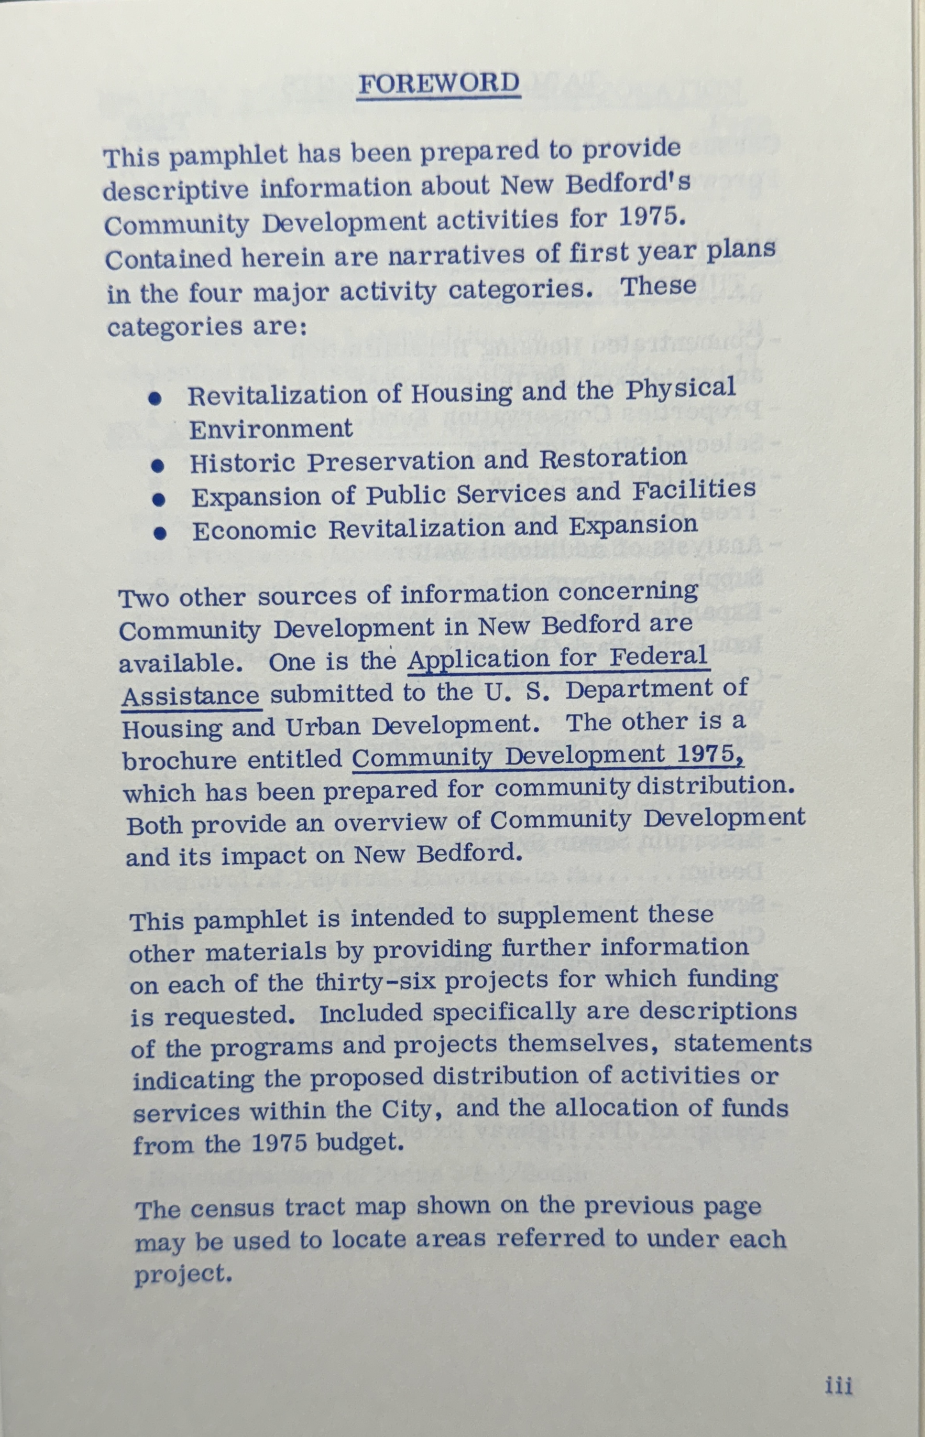
CDBG – 1975 New Bedford, Massachusetts, $10.2 million
Notes:
I found this original pamphlet from New Bedford in the very first year of the CDBG Program.

Slide 14
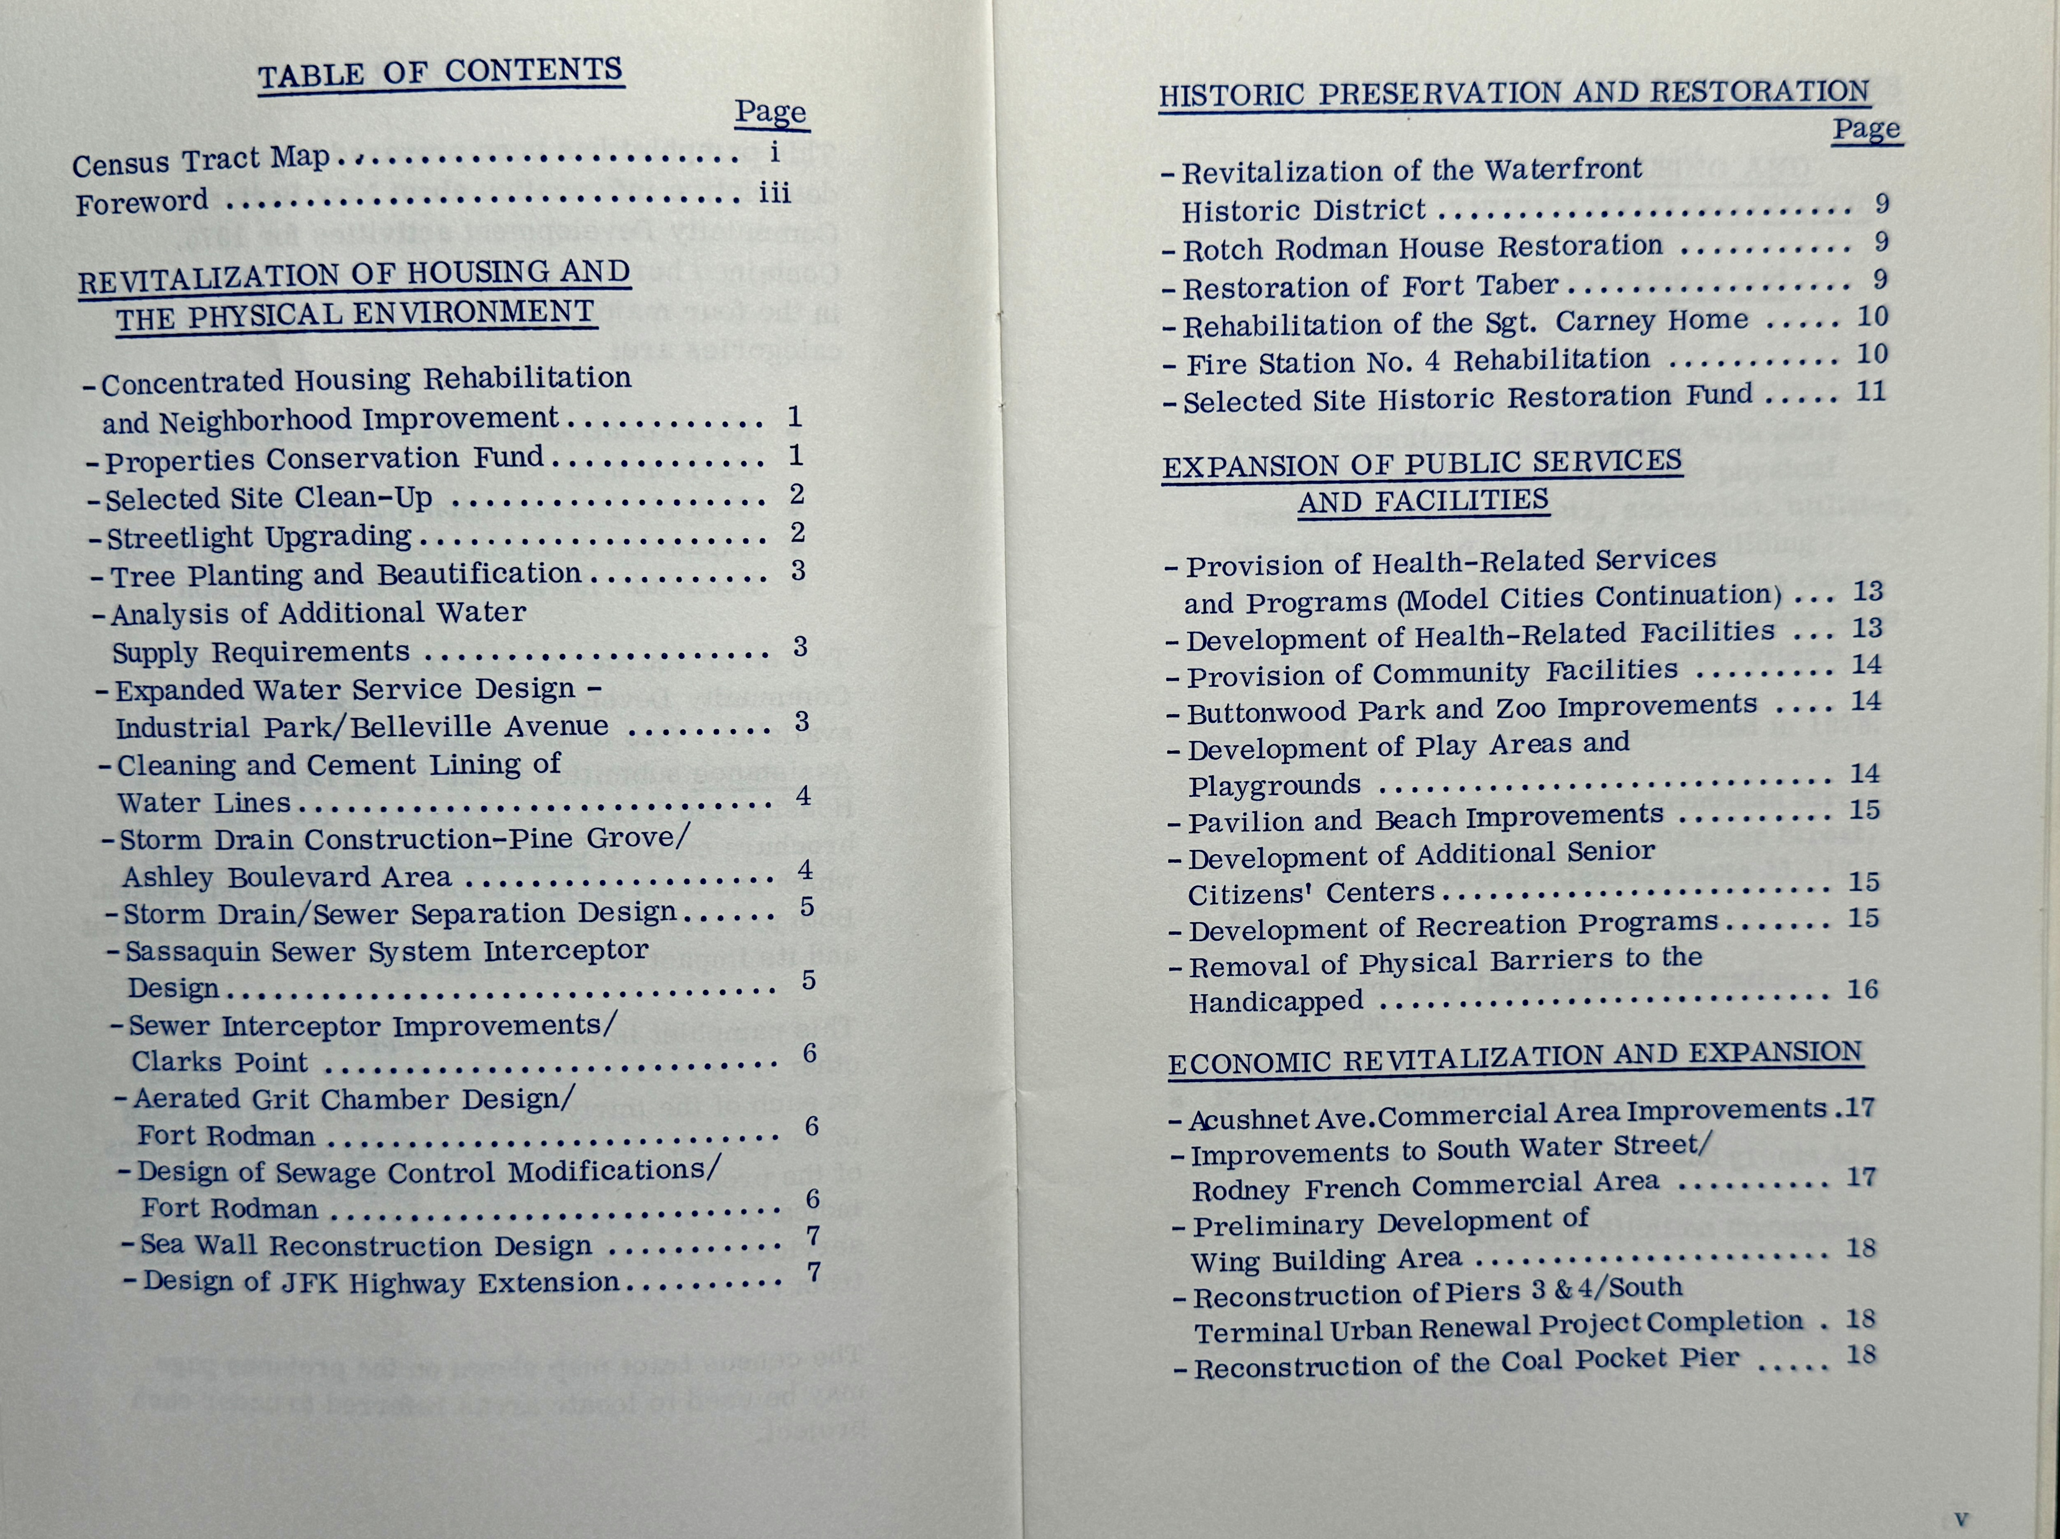
CDBG – 1975 New Bedford, Massachusetts, Cont.
$10 million in 1974 is the equivalent of $66,395,238 in 2024

Slide 15
Revenue Sharing - Foundation of CDBG Program
Embodies Federalism concepts
General Revenue Sharing (GRS)
Enacted in 1972
Expired in 1986
Special Revenue Sharing (SRS)
job training,
education,
transportation,
law enforcement,
community development
Notes:
Paul, can you discuss the significance of Revenue Sharing. Mark, can you tell us about some lessons learned from General Revenue sharing

Slide 16
Special Revenue Sharing Precursors to CDBG
Community Development Revenue Sharing (CDRS)
Better Communities Act
Introduced in 1973
More requirements than CDRS
Referred to committee (where it died)
Notes:
Paul please continue.

Slide 17
Categorical Programs Consolidated into CDBG
Open Space Land;
Urban Renewal (included grants and loan financing mechanism);
Neighborhood Development Program (included grants and loan financing mechanism);
Historic Preservation grants;
Model Cities Program grants;
Public Facility Loans;
Neighborhood Facilities grants; and
Water and Sewer grants.
Notes:
Each community had to submit separate applications for funding for each category of assistance. Could you each tell us a bit about that process and how it was much improved through the implementation of CDBG

Slide 18
Categorical Programs Consolidated into CDBG
Consolidated Categorical Programs into one program
13 eligible activities (versus 26 today)
80 percent of funding allocated to entitlement communities
No state CDBG program
HUD managed funding in non-entitlement areas
Notes:
Paul and Jim, from a HUD perspective tell us how the early years with eligible activities. How did the small cities feel about being “left out” of CDBG funding? What was it like for HUD managed funding in non-entitlement areas?

Slide 19
Section 108 - HCD Act of 1974
Eligibility: financing the acquisition or assembly of real property (including such expenses as the Secretary may permit by regulation)
Maximum amount: none
Security requirements:
HUD withholds an amount at least equal to 110 percent of the difference between the cost of acquiring the land and related expenses and the estimated proceeds to be derived from the sale or other disposition of the land
Pledge of FFC or revenues
Limited pledge of CDBG funds
Notes:
Paul you are our Section 108 HUD expert. Please take us through the next couple of slides.

Slide 20
Section 108 - HCD Act of 1977, Cont.
Eligibility: added rehabilitation of publicly owned real property
Maximum amount: none 3 times CDBG allocation
Security requirements:
Pledge of CDBG funds
Additional security as required by HUD
Notes:
Paul, Please take us through the next couple of slides.

Slide 21
CDBG and Section 108 Changes
HCD Act of 1983 – 51 percent overall LMI, Section 108 can be used to assist a grantee in obtaining financing only if the grantee has made efforts to obtain such financing without the use of such guarantee and cannot complete such financing consistent with the timely execution of the program plans without such guarantee.
HCD Act of 1987 – 60 percent overall LMI, housing rehab and economic development activities added to Section 108 eligibility list.
Notes:
Paul, Please take us through the next couple of slides.

Slide 22
CDBG and Section 108 Changes, Cont.
HCD Act of 1983 – 51 percent overall LMI, Section 108 can be used to assist a grantee in obtaining financing only if the grantee has made efforts to obtain such financing without the use of such guarantee and cannot complete such financing consistent with the timely execution of the program plans without such guarantee.
HCD Act of 1987 – 60 percent overall LMI, housing rehab and economic development activities added to Section 108 eligibility list.
Cranston-Gonzalez (1990) – HOME program created, 70 percent overall LMI, Section 108 changes:
108 eligibility for non-entitlement communities,
20- year repayment period, maximum amount 5 times CDBG allocation,
70/30 split between entitlement/nonentitlement public entities,
limits ($35m entitlement, $7m nonentitlement)
Notes:
Paul, Please take us through the next couple of slides.

Slide 23
CDBG and Section 108 Changes, Cont.
1994 (Multifamily Housing Property Disposition) –
Added public facilities/improvements as 108 eligible activity
Added 108(q) for economic development grants for use in conjunction with 108 loans (EDI and BEDI)
Added 108(r) authorizing HUD to guarantee trust certificates backed by pool of guaranteed loans
2009 (Transportation, Housing and Urban Development, and Related Agencies Appropriations Act) – authorized states to apply for direct guarantees under Section 108
Notes:
Paul, Please take us through the next couple of slides.

Slide 24
ECONOMIC DEVELOPMENT ACTIVITIES – DON’T BE AFRAID
Important component of regulations that can be sometimes underutilized
Job Creation/Retention
Micro Enterprise
Notes:
I remember when Jim was the HUD Region I Director in Boston. HUD was going to focus on economic development activities to monitor in communities that year and he worked with NCDA Region I to sponsor a luncheon at HUD headquarters and invited Region I Grantees to attend a session that Mark coordinated on how to effectively administer an Economic Development program and avoid running into monitoring issues. Can you both talk about that? Also, Mark- can you add your experience as a consultant with the Section 108 Program.

Slide 25
CDBG Changes During the Carter Administration
CDBG started fast and HUD had “hands off” approach in first two years
First group of improvements to CDBG was under Carter
Importance of Housing Assistance Plan (HAP) Continued
Urban Development Action Grants (UDAG) – 1977
Allowed local governments to make loans to private developers and businesses with HUD Grant
Economic development became big part of CPD workload
HUD played strong roll in urban policy – Sec Harris, Asst Sec Embry
Notes:
Jim could you speak to the Carter Administration. Mark, could you discuss the role of NCDA - heavily lobbied HUD on distribution policies, Formula issues,

Slide 26
Why CDBG Was Important?
Concept of a Block Grant instead of categorical programs – President Nixon’s “New Federalism”
Decentralized power from feds to local – CDBG called “the Mayors’ program”
Ended or curtailed flow of funds to special purpose forms of government like redevelopment authorities, CAP agencies
Consolidated tedious numerous separate applications into one program
Posed important questions:
What are eligible activities – the lists expanded over time
Targeting of funds and National Objectives
Local vs Federal Controls
Nature of an Application
Notes:
Could you all take a few minutes to talk us through - Why CDBG was Important?

Slide 27
The Reagan Administration Years
Created State CDBG Program
Created name Statement of Projected Use of Funds in place of application
Eliminated HUD front-end reviews, except for a complete submission
Began emphasis on performance reviews and monitoring
Program never returned to extensive front end reviews
Notes:
Jim, could you discuss the Reagan years.

Slide 28
CDBG Statutory and Regulation Changes over the Years
1977 CDBG Reforms, Regs in 1978
Stronger application
Targeting to LMI
Stronger HUD Reviews, more HUD influence
Economic development added to eligible activities
1981 (Omnibus Budget Reconciliation Act) - State CDBG program created, 70/30 split between entitlement/nonentitlement
Revised CDBG Economic Development Requirements – 1987
Statutory changes – 1992
Primarily impacting economic development activities, regs in 1995
How to do economic development always a CDBG challenge
Consolidated Plan Introduced – 1994. Prior to that only a HAP then CHAS submission required
Notes:
Paul and Jim. There were some significant changes to the CDBG Program over the years, how significant were these changes to the Program

Slide 29
CDBG USED AS A MODEL FOR NEW PROGRAMS
Housing and Urban-Rural Recovery Act of 1983 begins Housing Development Action Grant and Rental Rehabilitation programs.
McKinney Vento and Continuum of Care > Hearth Act – 1987 to Present
Cranston-Gonzalez National Affordable Housing Act creates HOME Program – 1990 to Present
CDBG-DR – Disaster Relief – Created in 1992 following Hurricane Andrew
Empowerment Zone (EZ), Enterprise Community (EC), and Renewal Community (RC) Initiatives – 1993 to 1998
Consolidated Plan – 1994 to present
The American Recovery and Reinvestment Act (ARRA) – 2009 – 2011-$831 billion
The Neighborhood Stabilization Program (NSP) – 2008 to 2010
CDBG-CV, HOME-ARP 2020 - Present
Notes:
Pat will describe

Slide 30
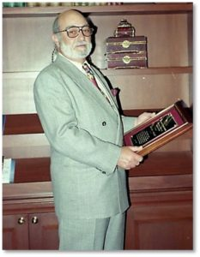
Model Cities Program and
Development of National Community Development Association NCDA
In 1970, John Sasso became the first Executive Secretary of the Model Cities Community Development Directors Association. In 1979, the name of the organization was changed a final time to the National Community Development Association (NCDA) after passage of the Housing and Community Development Act of 1974, which created the CDBG program. John began his tenure in the field of community development as a planner for the City of Pawtucket, RI. He retired from NCDA in 2000.
Notes:
Mark, tell us a bit about Model Cities Community Development Directors Association

Slide 31
National Community Development Association
“For 55 years, the National Community Development Association (NCDA) has been at the forefront in supporting the first grantees of the Model Cities Program and were at the table when the CDBG and HOME Programs were created to ensure local communities had a voice and the federal resources needed to continue the important work of revitalizing neighborhoods and assisting low-income people.
Our mission, experience and commitment to assisting local governments achieve high quality programs for making communities better places to live, particularly for low- and moderate-income people, drives our desire to provide the best services to our members. We are led by the passion of our members, the guidance of our Board of Directors, and the dedication of our staff.
NCDA is strong, resilient organization and we look forward to the next 55 years of serving our members and making communities better”.
Notes:
Mark tell us about the early years of NCDA. Partnership with USCM, Regional structures, CD professional license v. training certificate

Slide 32
Significance of NCDA in ensuring the continuation of CDBG
In 1968, Congress passed legislation authorizing the Model Cities Program
That same year the Model Cities Directors’ Association was formed to represent those cities receiving funding.
The Model Cities Program was replaced with the Community Development Block Grant (CDBG) Program in 1974.
With the change in programs came a change in name for the association to the National Model Cities and Community Directors’ Association.
In 1979, the name of the organization was changed a final time to the National Community Development Association (NCDA). Today, the NCDA membership is more than 500 and includes both cities and counties.
Notes:
Mark Continue.

Slide 33
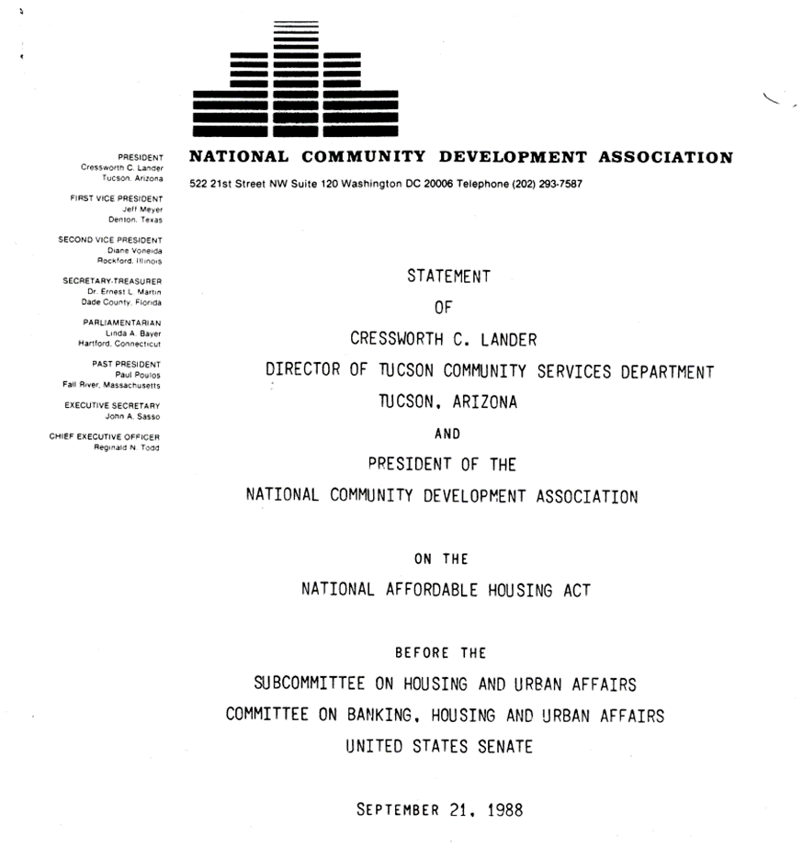
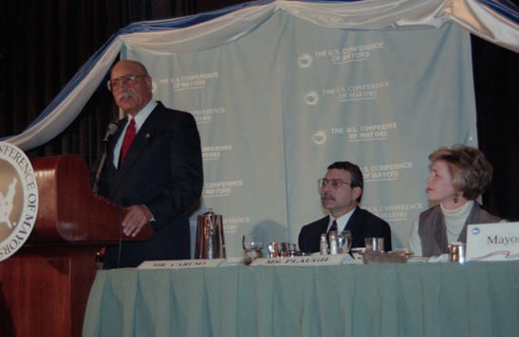
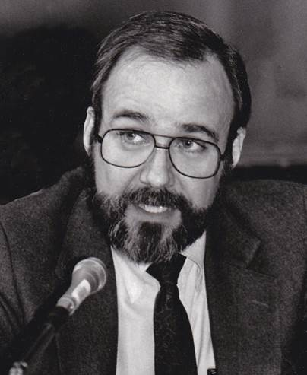
Significance of NCDA in ensuring the continuation of CDBG, Cont.
Advocacy and Testimony by NCDA members before Congress to ensure continuity with programs and significant input how legislation and regulations were formulated.
Cress Lander, Tucson, Arizona
Steve Gartrell, Newton, MA,

Slide 34
The Resilience of CDBG
2006 The Bush Administration proposed to cut the Community Development Grant by 90% and shift the funds to a new program called "Strengthening America's Communities Grant Program and be run by the Commerce Department
2018 The Trump Administration “blueprint” for 2018 would eliminate funding for the Community Development Block Grant program
2020 The Trump Administration Fiscal Year (FY) 2021 budget request would eliminate the HOME Investments Partnership program and Community Development Block Grants (CDBG)
Notes:
In 2006 Region I held a large press event with Congressman Barney Frank, and representatives from Senators Kennedy and Kerry’s offices to showcase the significance of CDBG and highlight the significance of the program, Each community on a similar template, highlighted CDBG programs and Projects.

Slide 35
What makes CDBG Special
Benefiting low- and moderate-income persons and communities
Address a wide range of community development needs
Housing, Economic Development, Infrastructure, Facilities,
Public Services
Local decision-making & flexible use of funds
Community input and citizen participation
Leveraging funding and creating partnerships
Strategic & targeted investment
Notes:
Mark, as one of the older members of NCDA & CD Professional, what lessons can you suggest for newer or younger members?

Slide 36
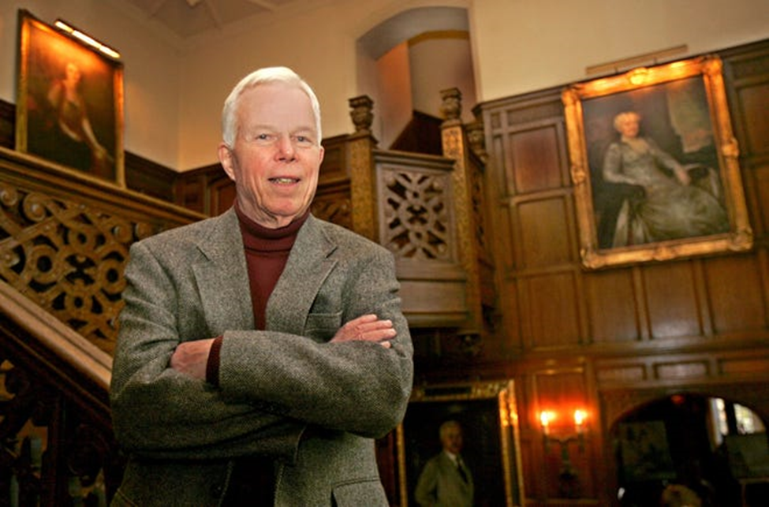
What makes CDBG Special? Ned Handy, Cambridge, MA
On February 27, 2023, at the age of 100 Ned passed away.
Ned was a legend in the field of planning and community development. In addition to his 30-year career in Cambridge as the Director of Community Development (retiring in 2000), he had previously worked in Providence; New York City; Chicago; San Jose, California; San Juan, Puerto Rico; and Bangkok, Thailand. He was one of the humblest, dedicated, public servants to work in the field of Community Development
All of us that called Ned a friend, never knew that Ned served his country in WWII. He was serving as a turret gunner and flight engineer aboard a B-24 Liberator when it was shot down over Germany in 1944. Ned was held for 13 months at Stalag 17, the notorious German prisoner-of-war camp that inspired the 1953 Hollywood movie “Stalag 17” starring William Holden.
Ned eventually wrote a book about his experiences - The Flame Keepers: The True Story of an American Soldier's Survival Inside Stalag 17.
Ned Handy, was a member of Akron Ohio’s “royal family,” He was a grandson of Goodyear Tire & Rubber co-founder F.A. Seiberling and his wife, Gertrude
Notes:
Pat and Mark speak to the Region I tribute.

Slide 37
Questions?

